Slide 1
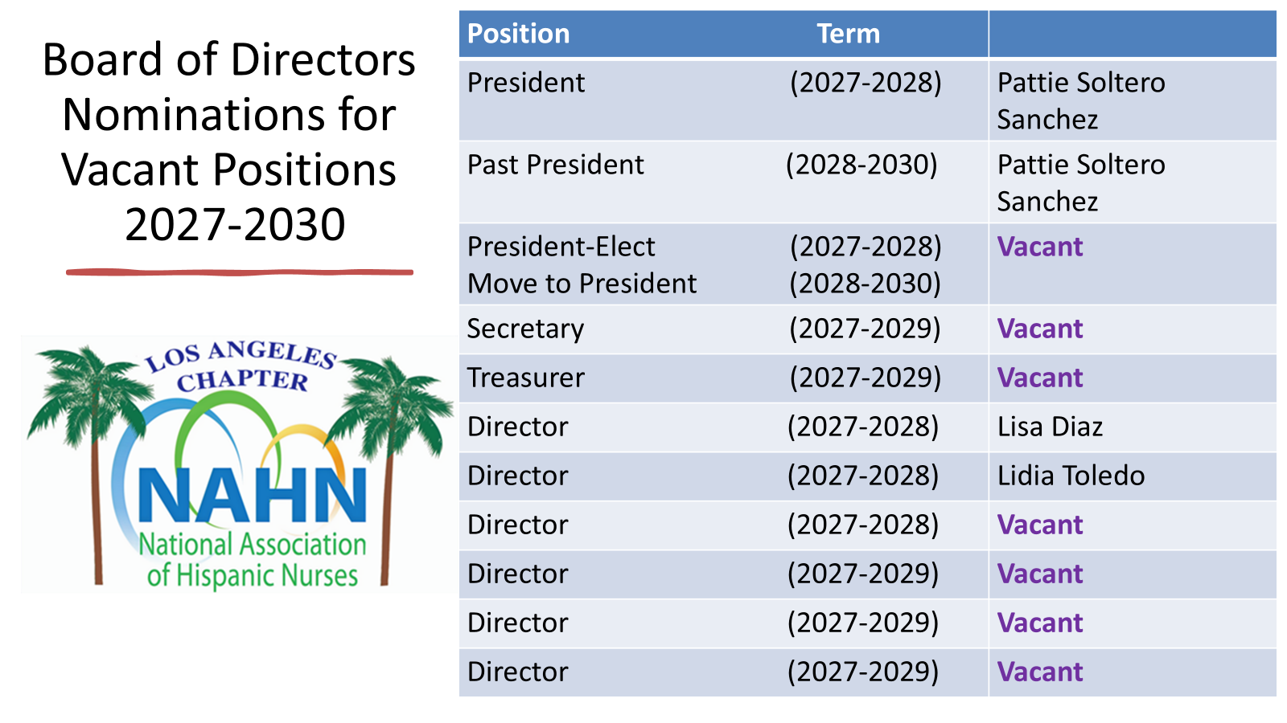

Slide 2
Board of Directors
Roles and Responsibilities
The Board of Directors shall exercise all corporate powers and manage the business and affairs of the Chapter, except as otherwise provided by law, or the Chapter's Bylaws. The duties of the Board in managing the Chapter shall include, but not be limited to, the following:
Establish the mission, purposes, goals, and program priorities to be implemented by the Chapter’s staff, through a strategic planning process;
Ensure that appropriate policies have been developed, adopted, and implemented by the Chapter to carry out its mission, specifically including policies pertaining to Members.
Determine and set overall policy;
Advocate the mission, values, accomplishments, and goals of the Chapter to the public at large;
Determine, monitor, and strengthen programs that are responsive to the needs of Hispanic nurses and are central to the Chapter’s mission;
Establish fiscal policy, including fiduciary responsibility for budget authorization and oversight;
Develop adequate resources to ensure financial stability for the Chapter’s activities;
Ensure the legal and ethical integrity of the Chapter;
Recruit, orient, and evaluate the Officers of the Board;
Respect and maintain the confidentiality of all matters of the Chapter that comes before the Board for which confidentiality is appropriate; and
Designate others, at its discretion, to carry out its duties and responsibilities defined in the Bylaws.

Slide 3
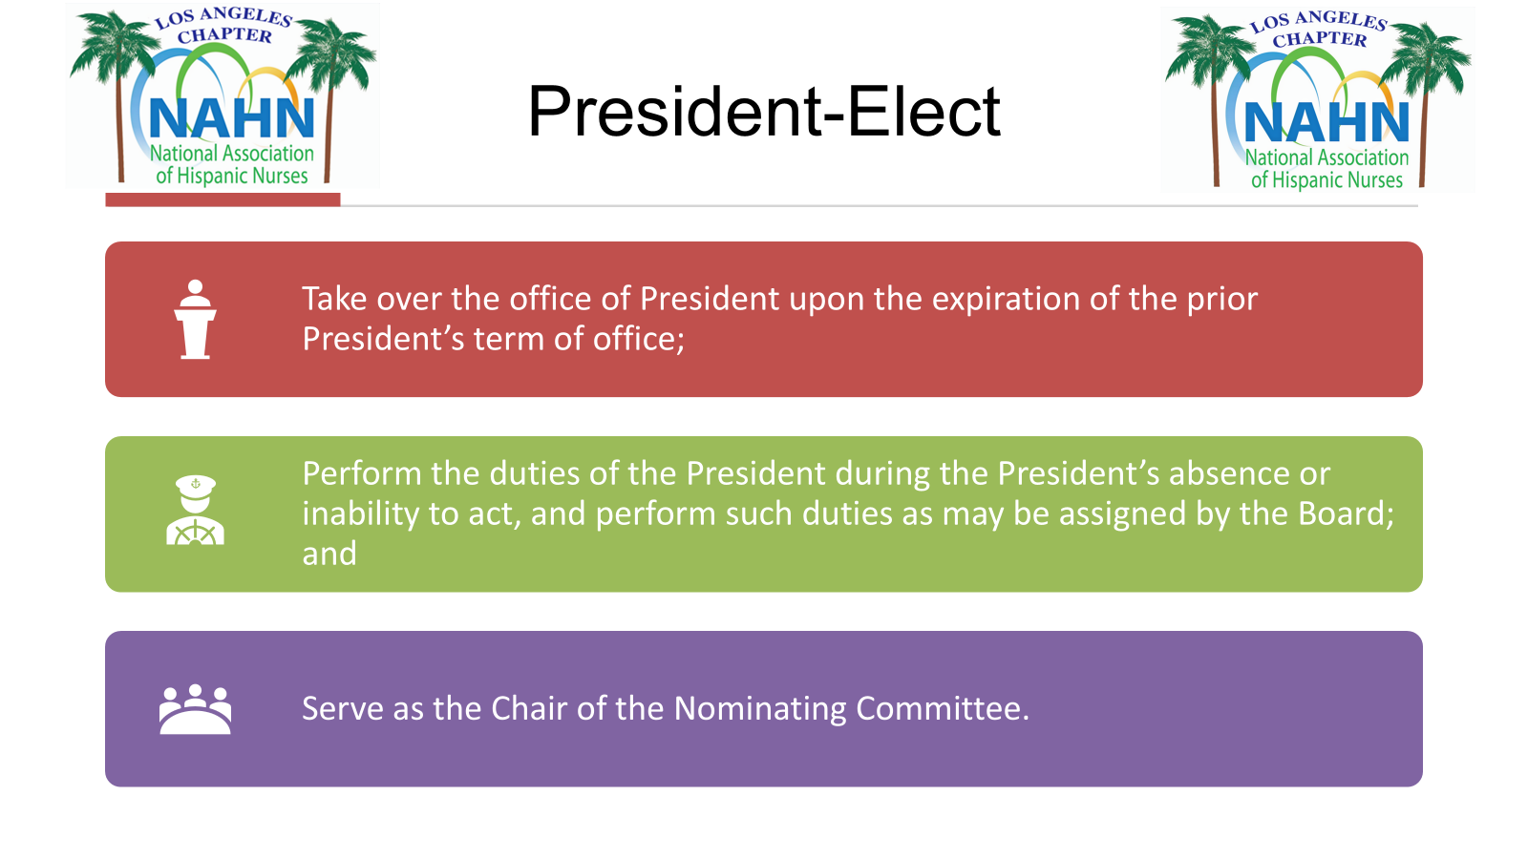

Slide 4
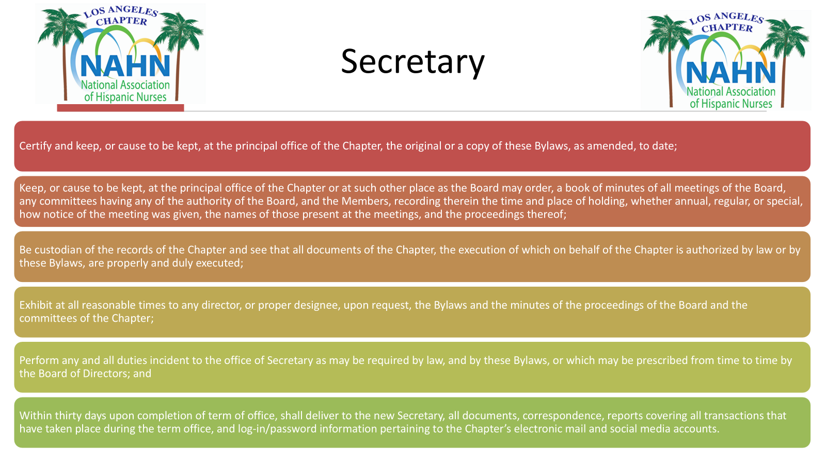

Slide 5
